Slide 1
Home Automation using IoT
Project by
JEGANATHAN PV 16104056
GOKUL RAJA TS 16104039
CHANDRA PRAKASH 16104025

Slide 2
Introduction
With advancement of Automation technology, life is getting simpler and easier in all aspects. In today’s world Automatic systems are being preferred over manual system. With the rapid increase in the number of users of internet over the past decade has made Internet a part and parcel of life, and IoT is the latest and emerging internet technology. Internet of things is a growing network of everyday object-from industrial machine to consumer goods that can share information and complete tasks while you are busy with other activities.

Slide 3
Software Utilized
Arduino IDE
ESP8266 drivers
IFTTT
ChatFuel
AdaFruit
Google Assistant / Facebook Messenger

Slide 4
Hardware Used
NodeMCU - CP210X
Description
Arduino IDE
Arduino IDE is an open-source software program that allows users to write and upload code within a real-time work environment.
ChatFuel
Chatfuel was founded in 2005 with the goal to make bot-building easy for anyone. It started on Telegram and quickly grew to millions of users. Today they focus mainly on making it easy for everyone to build chatbots on Facebook Messenger.

Slide 5
IFTTT
If This Then That, also known as IFTTT, is a free web-based service to create chains of simple conditional statements, called applets. An applet is triggered by changes that occur within other web services such as Gmail, Facebook, Telegram, Instagram, or Pinterest.
Google Assistant
Google Assistant is an artificial intelligence-powered virtual assistant developed by Google that is primarily available on mobile and smart home devices. Unlike the company's previous virtual assistant, Google Now, the Google Assistant can engage in two-way conversations.

Slide 6
Facebook Messenger
Facebook Messenger is a messaging app and platform. Originally developed as Facebook Chat in 2008, the company revamped its messaging service in 2010, and subsequently released standalone iOS and Android apps in August 2011.
Adafruit
Adafruit Industries is an open-source hardware company based in New York City. It was founded by Limor Fried in 2005. The company designs, manufactures and sells a number of electronics products, electronics components, tools and accessories

Slide 7
NodeMCU - CP210X
Features
Wi-Fi Module – ESP-12E module similar to ESP-12 module but with 6 extra GPIOs.
USB – micro USB port for power, programming and debugging
Headers – 2x 2.54mm 15-pin header with access to GPIOs, SPI, UART, ADC, and power pins
Misc – Reset and Flash buttons
Power – 5V via micro USB port
Dimensions – 49 x 24.5 x 13mm

Slide 8
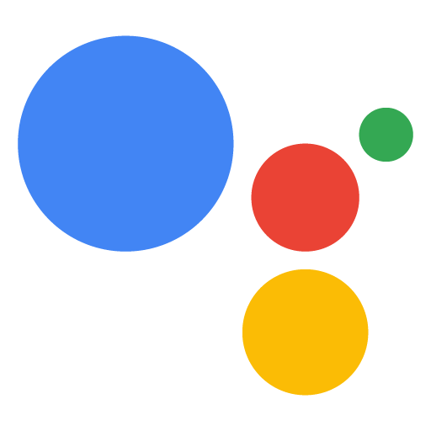




Flow Diagram
WiFi
Fetch from adafruit
execute

Slide 9
Usage
The aim of this project is to automate the task of turning on and off electrical devices. These range from everyday devices like lights and fans to heavy machinery like washing machines
The automation helps the user save some valuable time and gives control over the devices at their fingertips.Since it is connected over the internet the devices can be controlled remotely too
It will especially benefit the elderly and disabled who cannot move around easily

